Slide 1

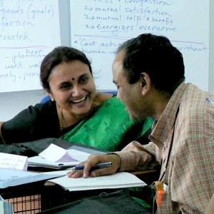

Dr J Balamurugan

Slide 2
Values
“Value” – from the Latin “valere”: “to be strong”,
“to be worth”
  Values are feelings and convictions regarding what is of “strong worth” (i.e. “important”) to us in what we think, say or do
  “A value is a principle or a quality that is considered worthwhile or desirable… validated by social approval.”
Values are inherent in all societies – ideals and shared beliefs that bond a community together

Slide 3
Social Values
Social values and norms explain the way in which social processes operate in a given society.
Social Values account for the stability of the social order.
It provide the general guidelines for conduct that what is right and important for the society.
Thus, values such as respect for human dignity, sacrifice, helpfulness, co-operation, honesty, loyalty, etc., guide our behaviour in various ways.
In doing so, they facilitate social control.

Slide 4

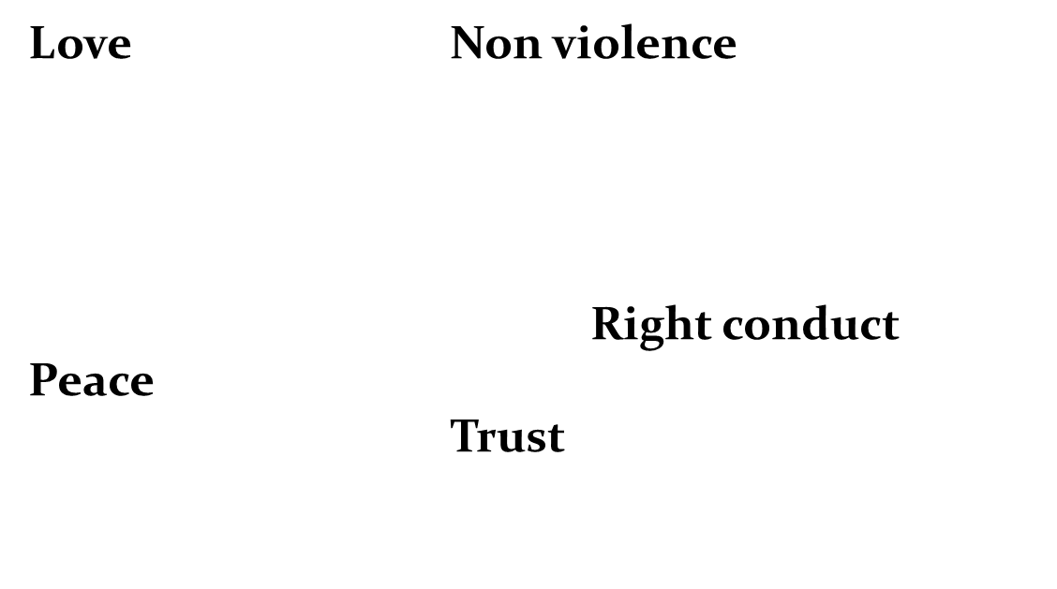

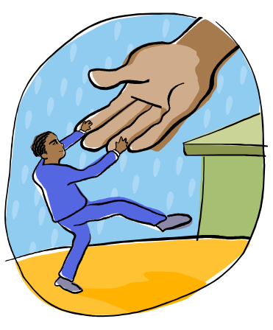


Personal values

Slide 5
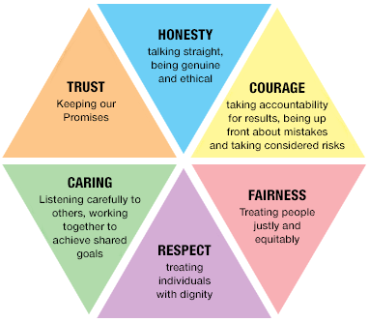

Slide 6
Professional values
How many people here are:
  100% perfect in living by professional values at work?
  0% perfect in living by professional values at work?
Just as we need to practice physical hygiene each day, we also need to practice “personal, social and professional values hygiene” each day

Slide 7

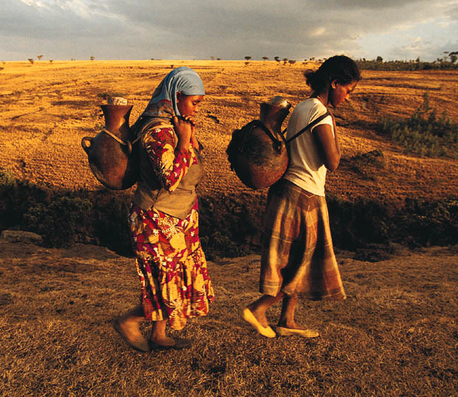
Successful people attach lot of value to their life.
In absence of these values none of the other success principles really work.

Slide 8
Human values “hygiene”
Our “purity” in living human values is like the purity of water…
  If a stream of water is unpolluted, its purity naturally shines forth
  If the water is full of dirt, its purity is hidden,
  but its essential nature is still there
To clean up polluted water, we must increase the flow of pure water and reduce the pollution
In the same way, to practice “human values hygiene” we must cultivate positive habits and remove negative habits

Slide 9
Significance of values
Values are necessary for satisfying your own needs.
Values helps you establish what is important in your life.
Understanding your values prevents you from justifications that lead to unhappiness.
Values help shape your behaviour.
Values help guide us, even when rules are absent.
Enhances cooperation.
Assists in dealings.
Builds public support.

Slide 10
Practicing human values “hygiene”
To cultivate positive habits:
  What practices outside of work best support you in living human values?
  What practices at work best support you in living human values?
To remove negative habits:
  What habits would you be willing to give up that hinder your ability to live human values at work and society?

Slide 11
Development of human values
Family
Education
Religion
Social background
Culture

Slide 12
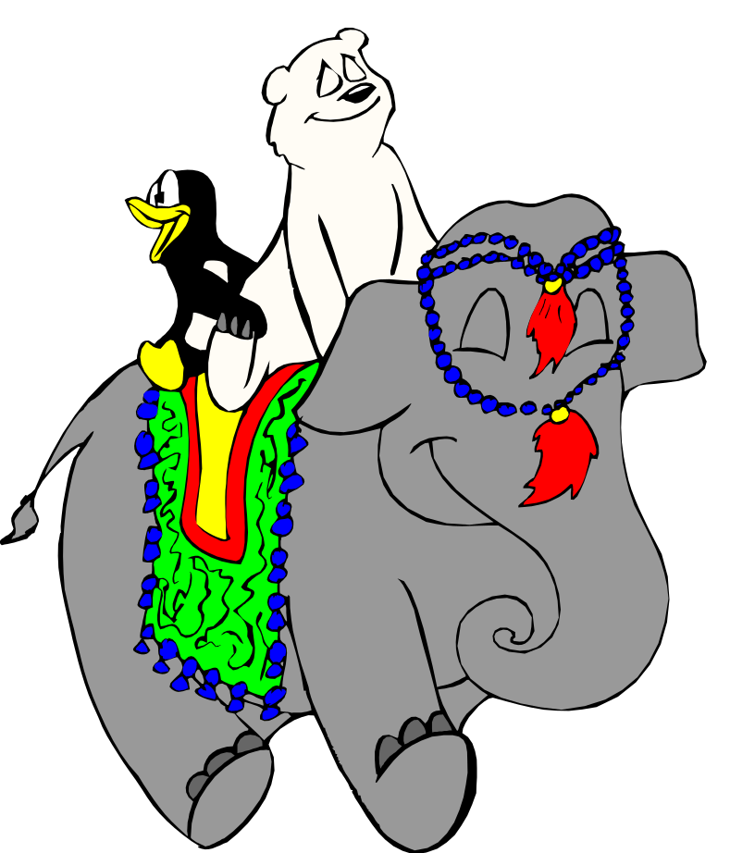
THANK YOU

